Slide 1

Phishing Websites Classification
Ghalia Maher
Jamila Rabeh
Ghadeer Ali
Supervised by Dr.Mejdal Alqahtani

Slide 2
WorkFlow Plan
Define the problem
Classifier Models Design
Classifier Models Model Evaluation
Data Exploration and pre-processing
Classifier Models 3 Approaches
01
03
05
02
04

Slide 3

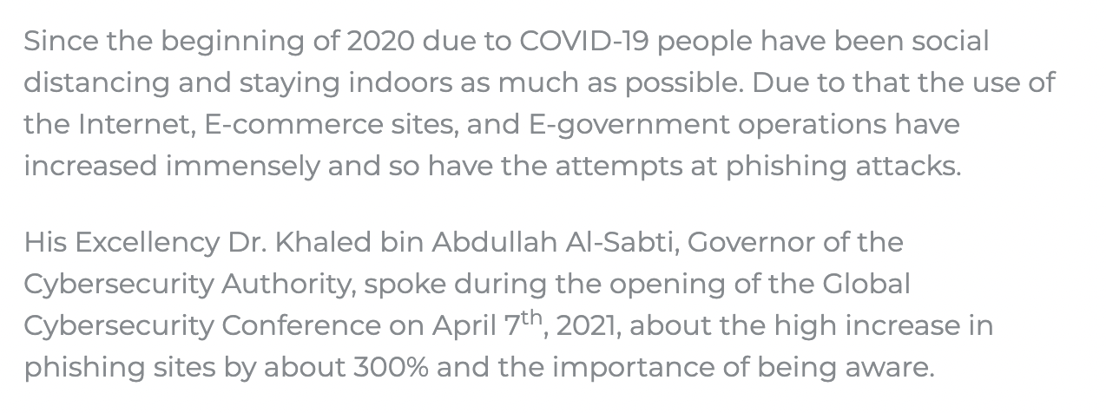
Is this link trusted?

Slide 4
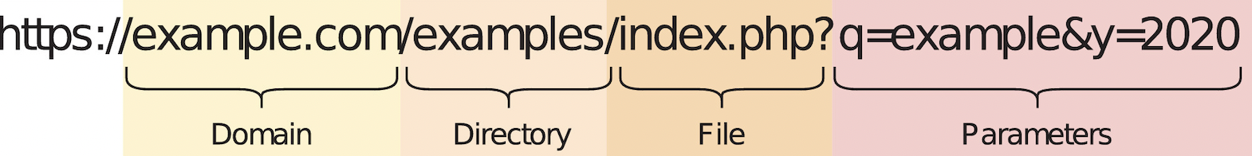
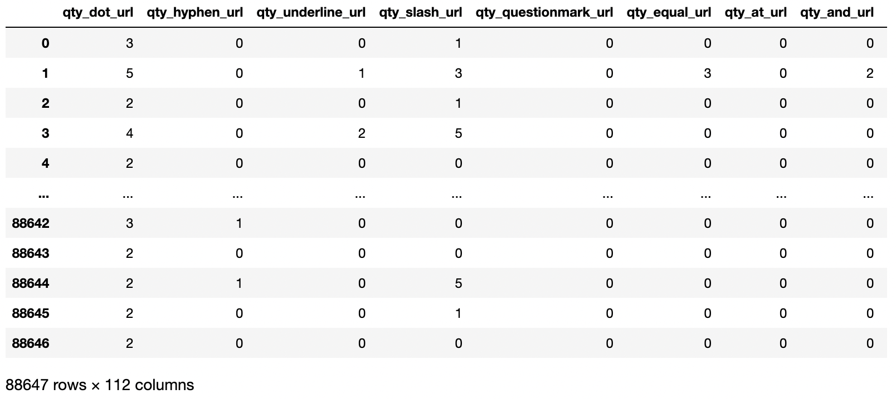
Data Exploration and pre-processing

Slide 5

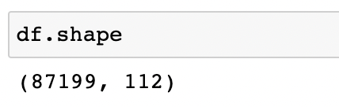
Data Exploration and pre-processing
Data cleaning
- Replace all negative values with zeros.
- Divide data frame into features and target.
- Check if the data contains missing value.
- Drop duplicated rows or records.

Slide 6
Design
1. Decision tree.
2. Logistic regression.
3. Support vector machine.
4. Naïve bayes.
5. Random forest.
6. K-Nearest Neighbor.

Slide 7
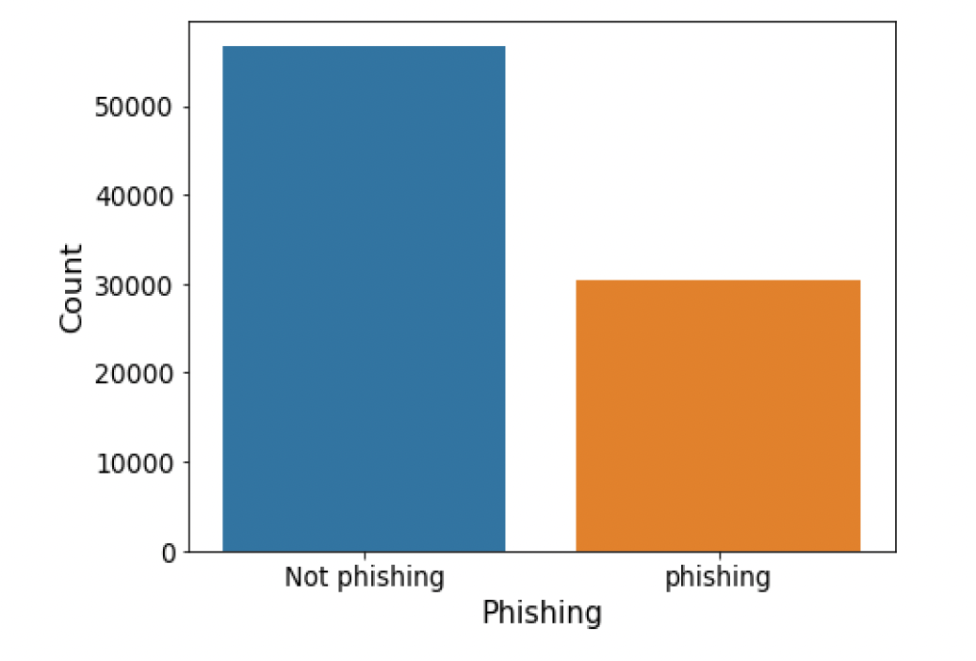
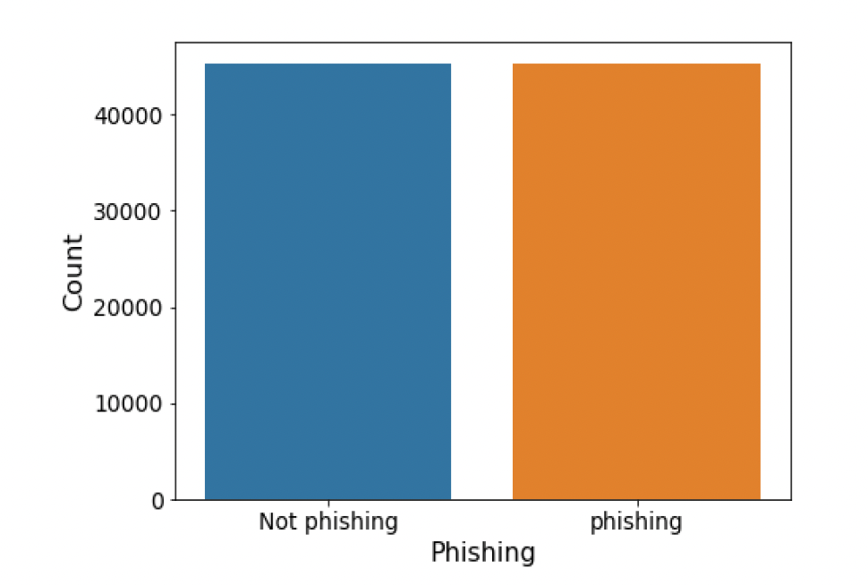
3 Approaches
First Approach
Second Approach
Third Approach
Applying classifiers without scaling and modifying the data.
Applying smote to balance the data.
Balance the data and then scale.

Slide 8
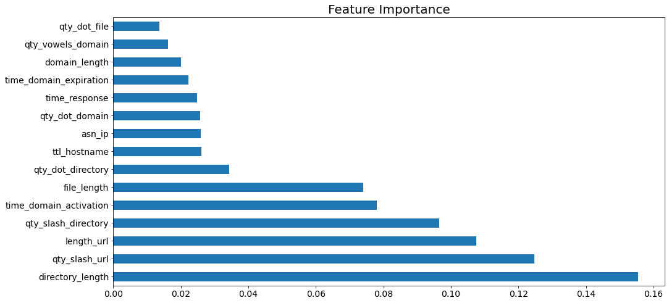
Applying classifiers without scaling and modifying the data feature importance of the high classifier score (Random Forest)
First Approach

Slide 9
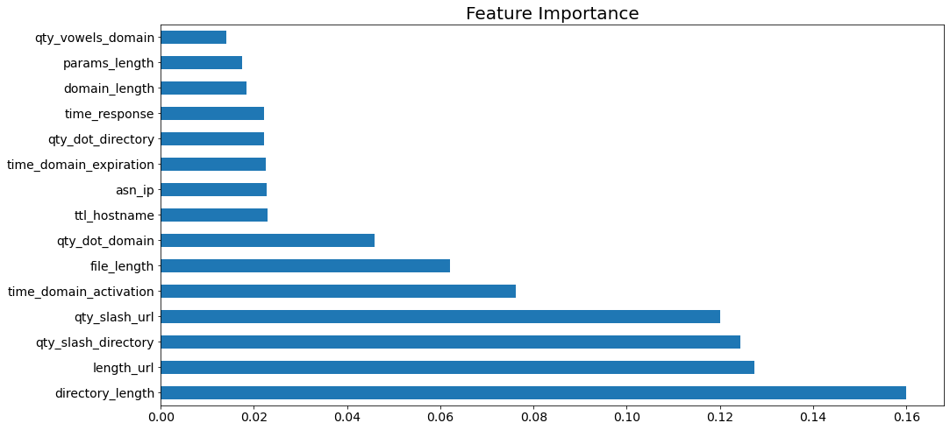
Second Approach
Applying smote to balance the data feature importance of the high classifier score (Random Forest)

Slide 10
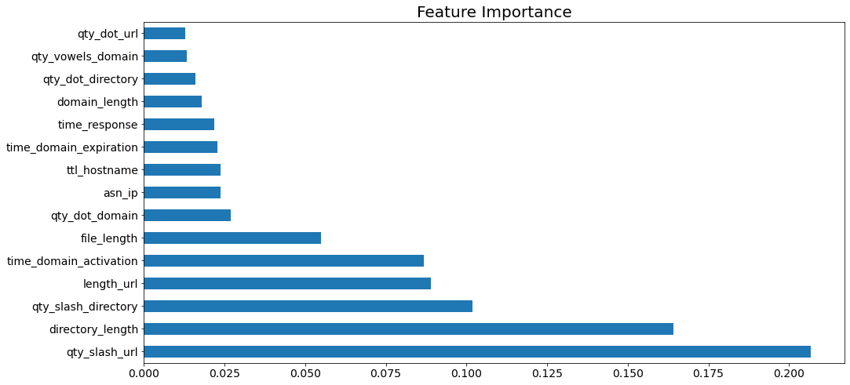
Third Approach
Balance the data and then scale feature importance of the high classifier score (Random Forest)

Slide 11
Model Evaluation
1. Accuracy.
2. Precision.
3. Recall.
4. Roc_auc.
5. F1 scores.
6.ROC curves

Slide 12
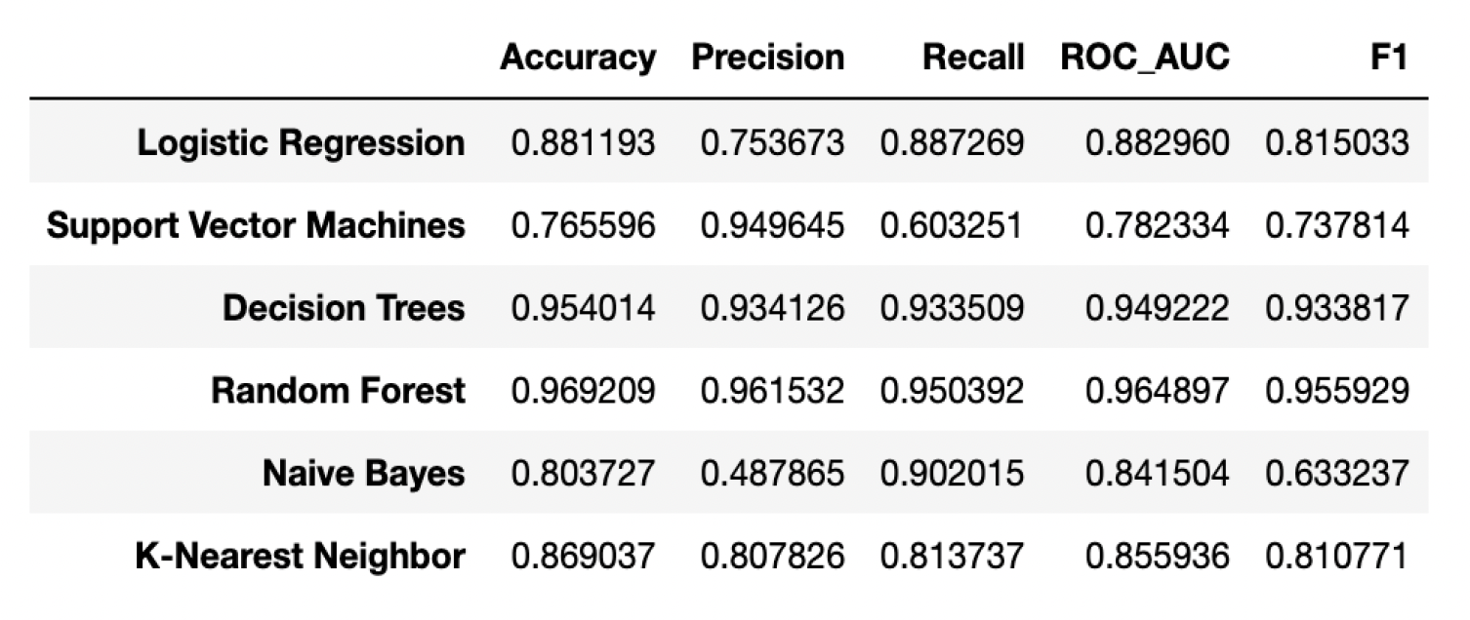
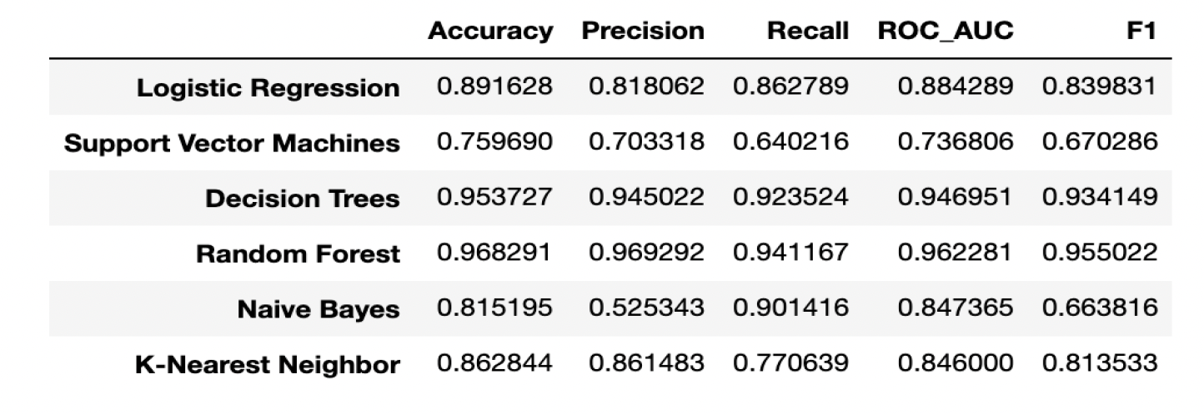
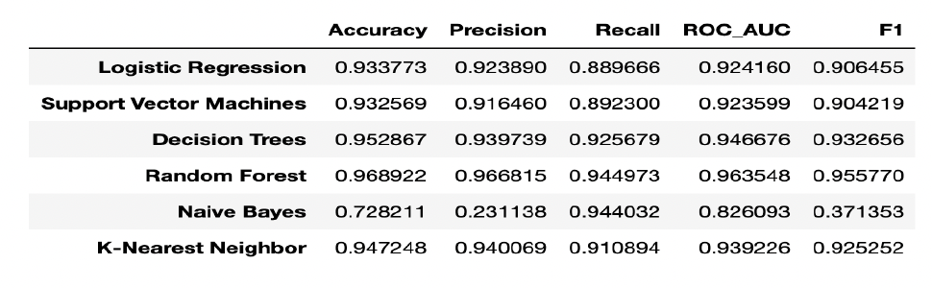
Metrics results
1
2
3

Slide 13
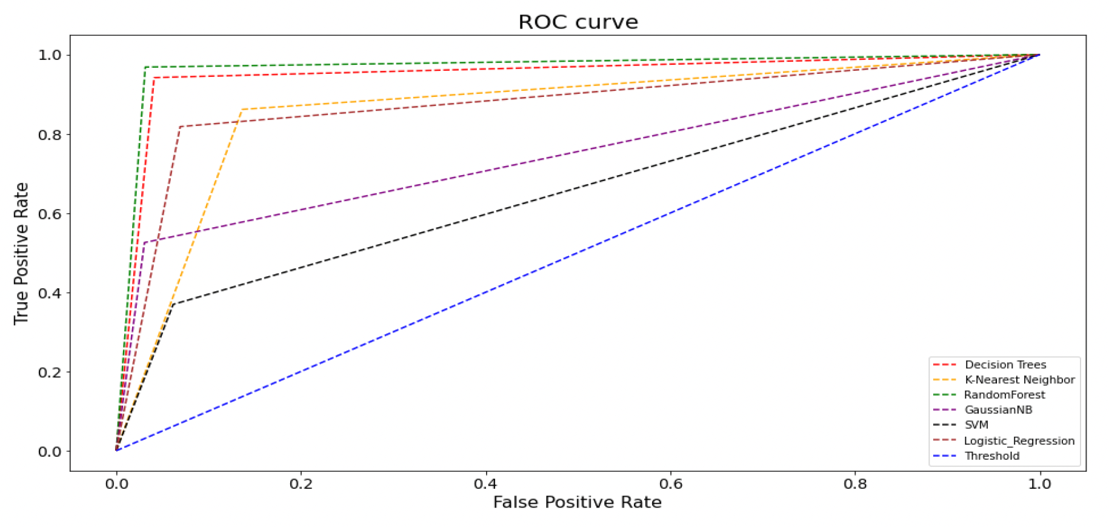
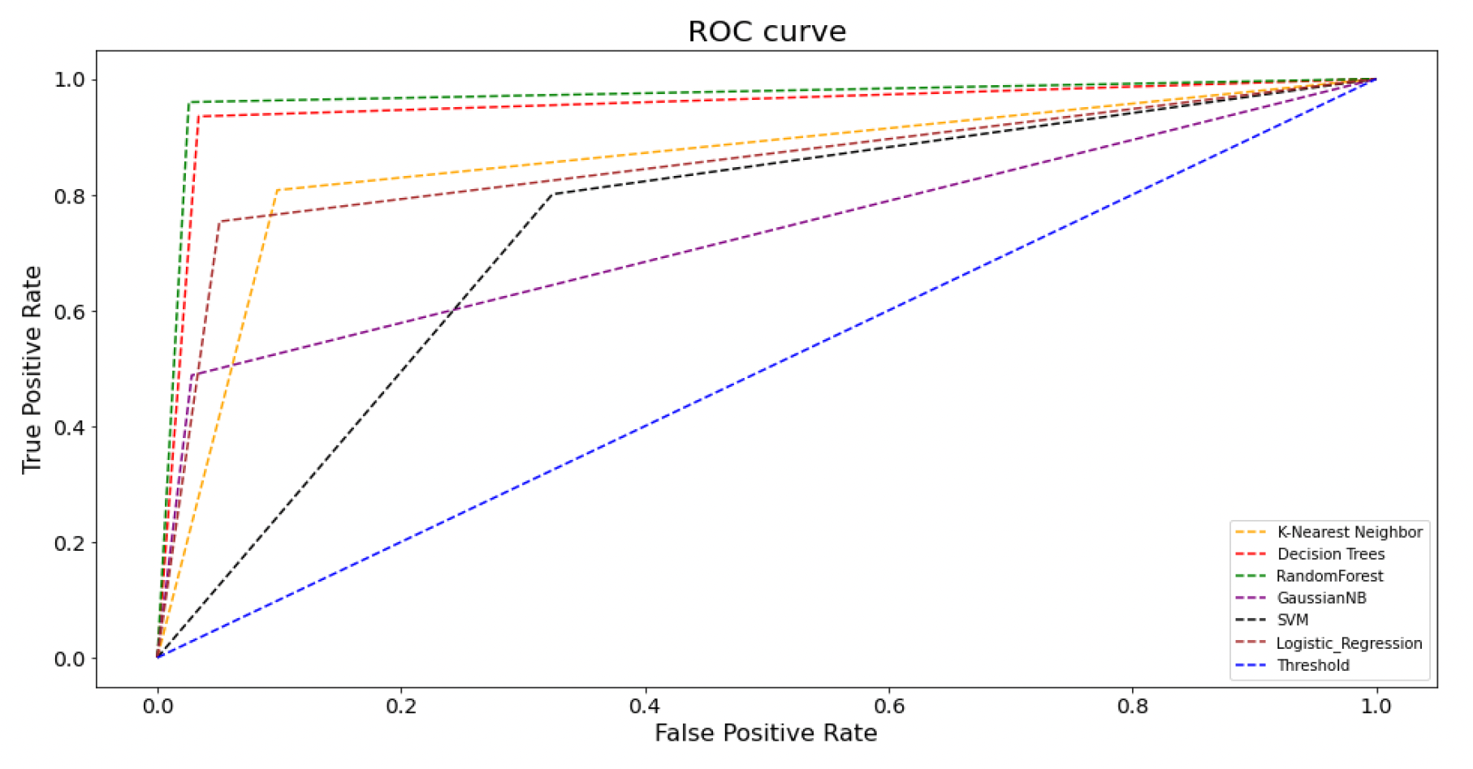
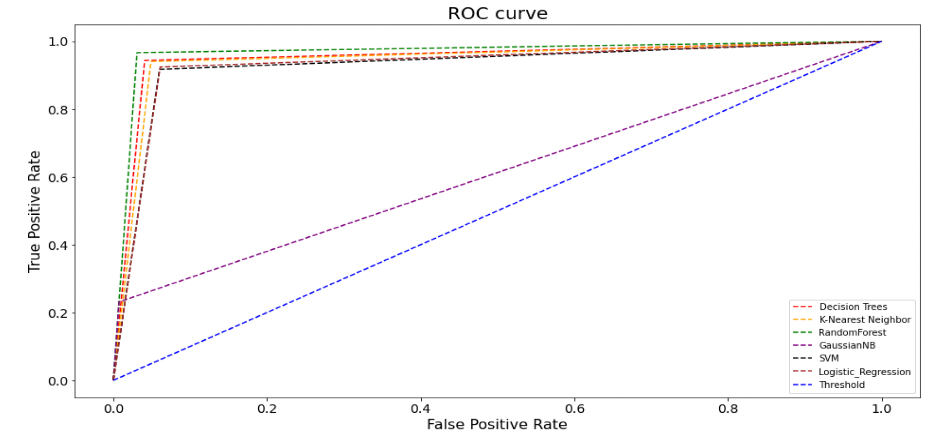
ROC curves visualization
2
1
3

Slide 14
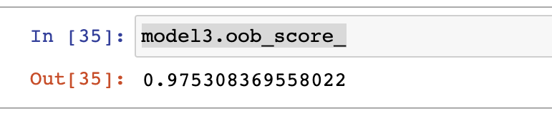
After All..
After applying the three approaches :
The best classifier was Random Forest in all approaches with the Out of Bag score equal 0.97
The classifiers that are sensitive to feature scaling got a good score in the third approach

Slide 15
In the End..
“Good protection comes first by educating ourselves and people around us.”

Slide 16
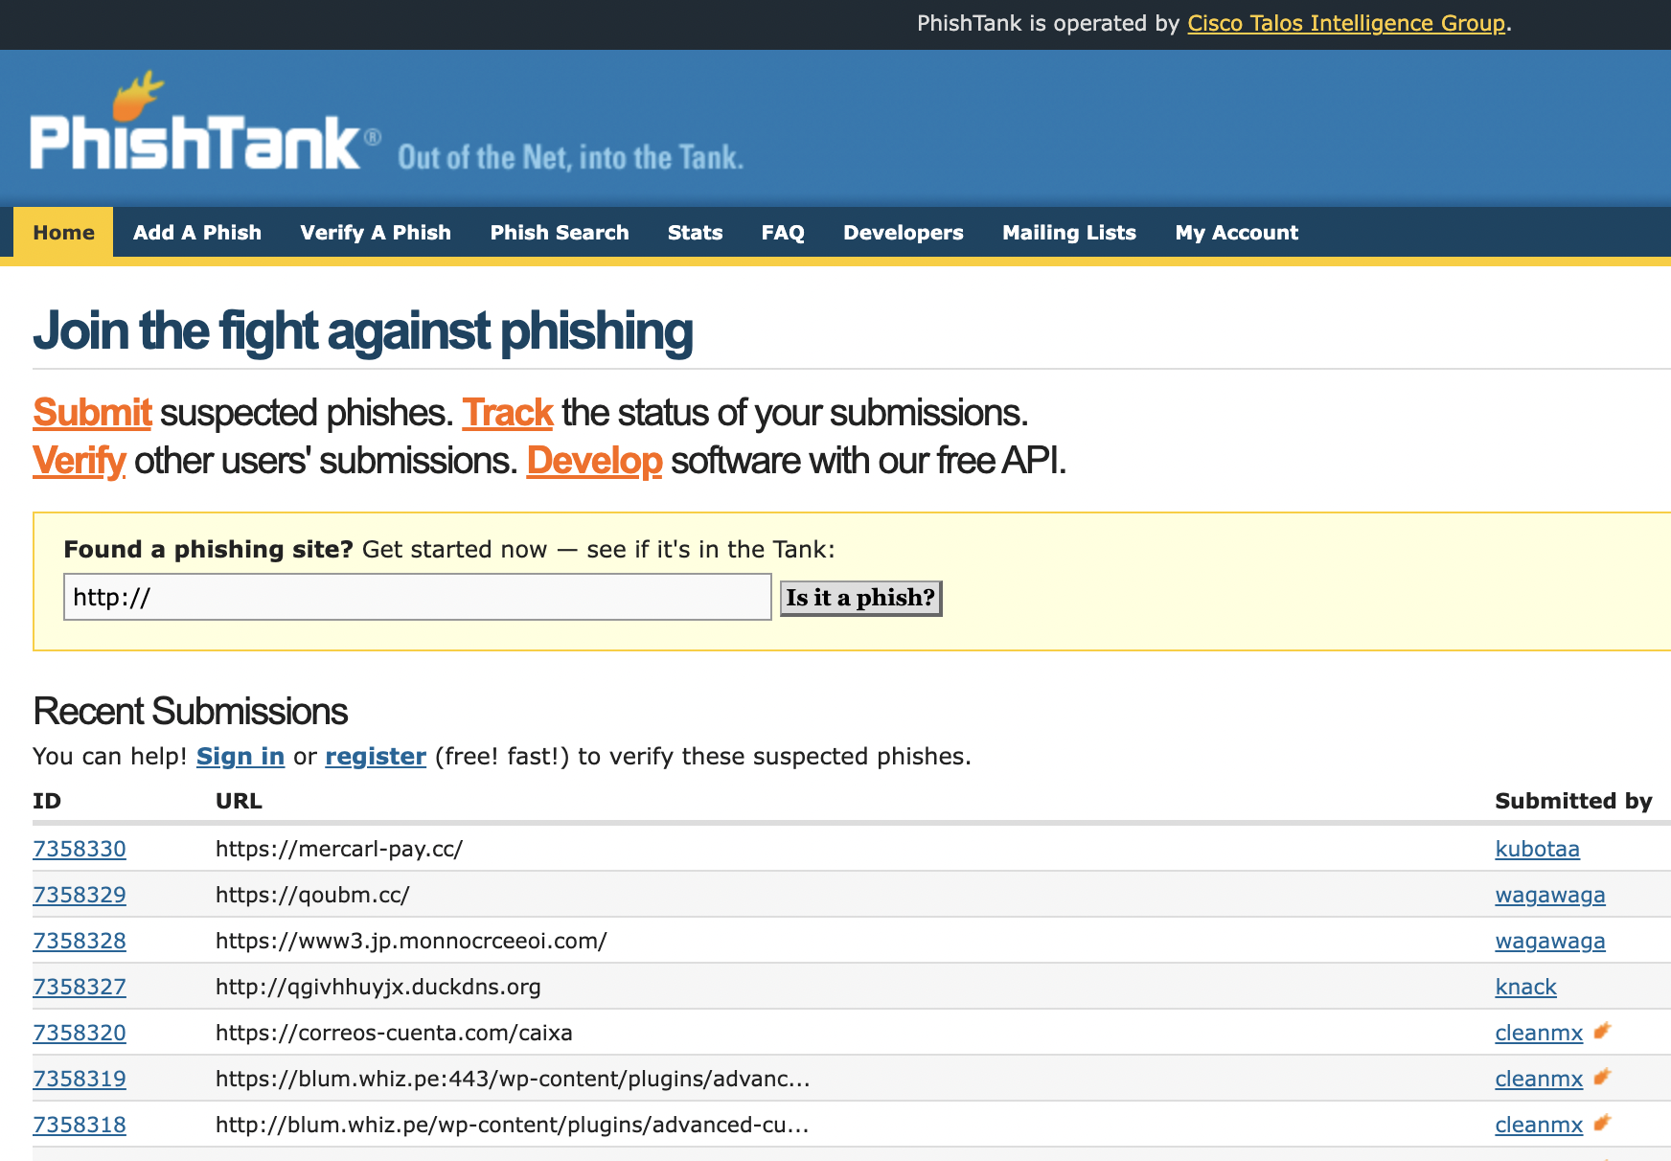
Future Work
Making huge local dataset of phishing websites similar to PhishTank.com

Slide 17
THANKS!
Time to have fun..

